Slide 1

AL-FARABI KAZAKH NATIONAL UNIVERSITY
Department of political science and political technologies
Methodology of modern political research
Abzhapparova A.A.
Senior lecturer

Slide 2
Methodology of modern political
Lecture 5
Causality and correlation: what does B when A does that Spurious correlation

Slide 3
Correlation vs. causation
Correlation research allows us to predict relationships between variables; if we know the state of one variable, we can generalize what is happening with the other variable
Correlation does not tell us if changing one variable will cause a change in the other variable
  Example 1: socioeconomic status and health
  Example 2: smoking and low grades (How to Lie with Statistics, Darrell Huff (1982))
Avoid ‘post-hoc fallacy’ which is a logical fallacy that states "Since event Y followed event X, event Y must have been caused by event X.

Slide 4
Units of analysis
The what or whom being studied. In social science research, the most typical units of analysis are individual people.
Are we studying individuals or groups of individuals? Which of the two is researcher’s primary focus?
Unit of analysis vs. unit of observation
Units of analysis are things we examine in order to create summary descriptions of all such units and to explain differences among them
Most common units of analysis: individuals, groups, organizations, social interactions, social artifacts

Slide 5
Individuals
Most typical unit of analysis for social research
Although any time of individual maybe unit of analysis, focus is on individuals with certain characteristics defined by research question
Descriptive studies with individuals as their unit of analysis typically aim to describe the population that comprises those individuals, while explanatory studies aim to discover the social dynamics operating within that population

Slide 6



Groups
We may be interested in characteristics that belong to one group, considered as a single entity (e.g. criminal or a gang, family access to computers)
Units of analysis at the group level could be friendship cliques, married couples, cities, geographical regions, etc.

Slide 7
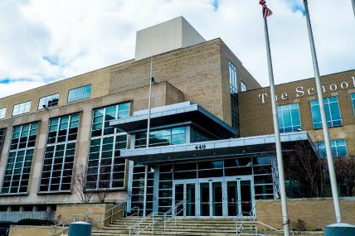


Organizations
Formal social organizations may also be units of analysis
Corporations, colleges, supermarkets, schools, courts, etc.

Slide 8



Social interactions
Instead of individual humans, you can study what goes on between them: telephone calls, fights, dancing, kisses, debates, etc.

Slide 9
Faulty reasoning about units of analysis
Ecological fallacy: assumption that something learned about an ecological unit says something about the individuals making up that unit
  Example: female candidate support basis, African American crime levels
Often occurs when most appropriate data are not available
Reductionism involves attempts to explain a particular phenomenon in terms of limited and/or lower-order concepts. Reductionist explanations are not altogether wrong; they are just limited.
  Example: predicting victory of a National Football team
Discipline driven reductionist explanations: economic, psychological, cultural, political, etc.
Reductionism of any type tends to suggest that particular units of analysis or variables

